Slide 1
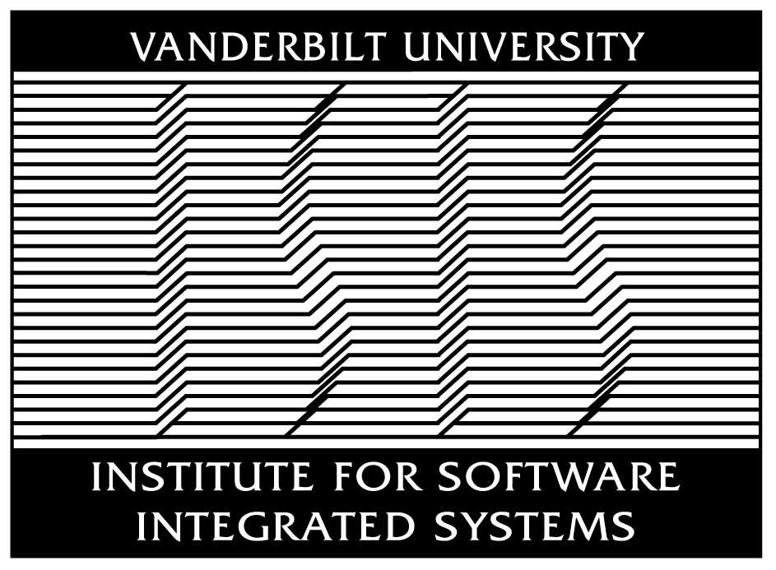
ROSMOD: A Toolsuite for Modeling, Generating, Deploying, and Managing Distributed Real-time Component-based Software using ROS
Pranav Srinivas Kumar, William Emfinger, and Gabor Karsai
Institute for Software-Integrated Systems
Vanderbilt University
This work was supported by DARPA under contract NNA11AB14C and USAF/AFRL under Cooperative Agreement FA8750-13-2-0050, and by the National Science Foundation (CNS-1035655). The activities of the 2014-15 Vanderbilt Aerospace Club were sponsored by the Department of Mechanical Engineering and the Boeing company. Any opinions, findings, and conclusions or recommendations expressed in this material are those of the author(s) and do not necessarily reflect the views of DARPA, USAF/AFRL, NSF, or the Boeing Company.

Slide 2
Introduction
ROSMOD is a Model-driven Development (MDD) Toolsuite
Designed for Rapid Prototyping Component-based Distributed Real-time Embedded (DRE) Applications with the Robot Operating System (ROS)
Well-suited for large-scale cyber-physical applications on distributed embedded devices
Includes a Graphical User Interface & Rendering Platform to enable model-based development
Supports ROS Workspace code generation with code preservation
Supports parallel deployment and monitoring of ROS processes
Real-World Application: An Autonomous Ground Support Equipment (AGSE) robot for the NASA Student Launch competition, 2014-2015.

Slide 3
Robot Operating System (ROS)
Meta-operating system framework for Robotic System Development
Open-Source Multi-Platform Support
Industrial Robotics, UAV Swarms, Low-power Image Processing Devices, etc.
Requirement in several DARPA Robotics Projects (DRC)
Enables Development of Network of Interacting ROS nodes
Various Interaction Patterns: Client-Server, Publish-Subscribe, and Time-triggered Operations
ROS Applications are packaged set of ROS nodes
ROS Master: Singleton Discovery and Communications Broker

Slide 4
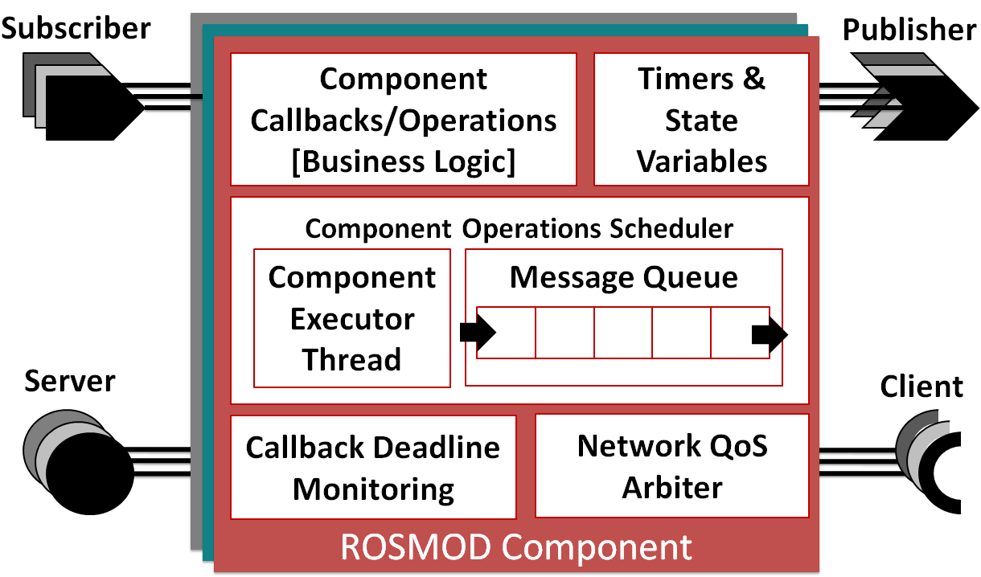
ROSMOD Component

Slide 5
Component Model
Each Component has a Message Queue
Each Component has a single executor thread
Each Component exposes operations through port interfaces.
Message Queue receives operation requests from other components
Component Operation Scheduler schedules one request at a time from the queue
Requests are processed based on a scheduling scheme e.g. FIFO, PFIFO, or EDF scheduling
Operation execution is single-threaded (i.e. nonpreemptive) per component
Single threaded operation execution helps avoid synchronization primitives and locking mechanisms in application code

Slide 6
ROSMOD Projects: Models
Software Model
Represents a ROS Workspace
Defines Messages, Services and Components
Hardware Model
Defines Hardware Devices - IP Address, SSH Keys, Architecture etc.
Deployment Model
Define ROS Nodes (Processes)
Instantiate Components (from Software Model) in ROS Nodes
Define a ROS Node to Hardware Mapping

Slide 7
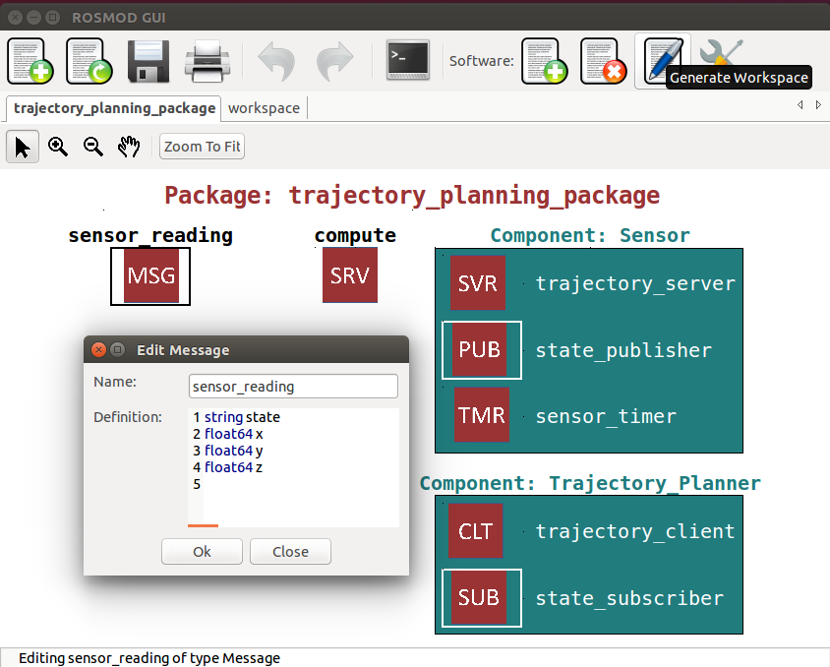
Graphical User Interface

Slide 8
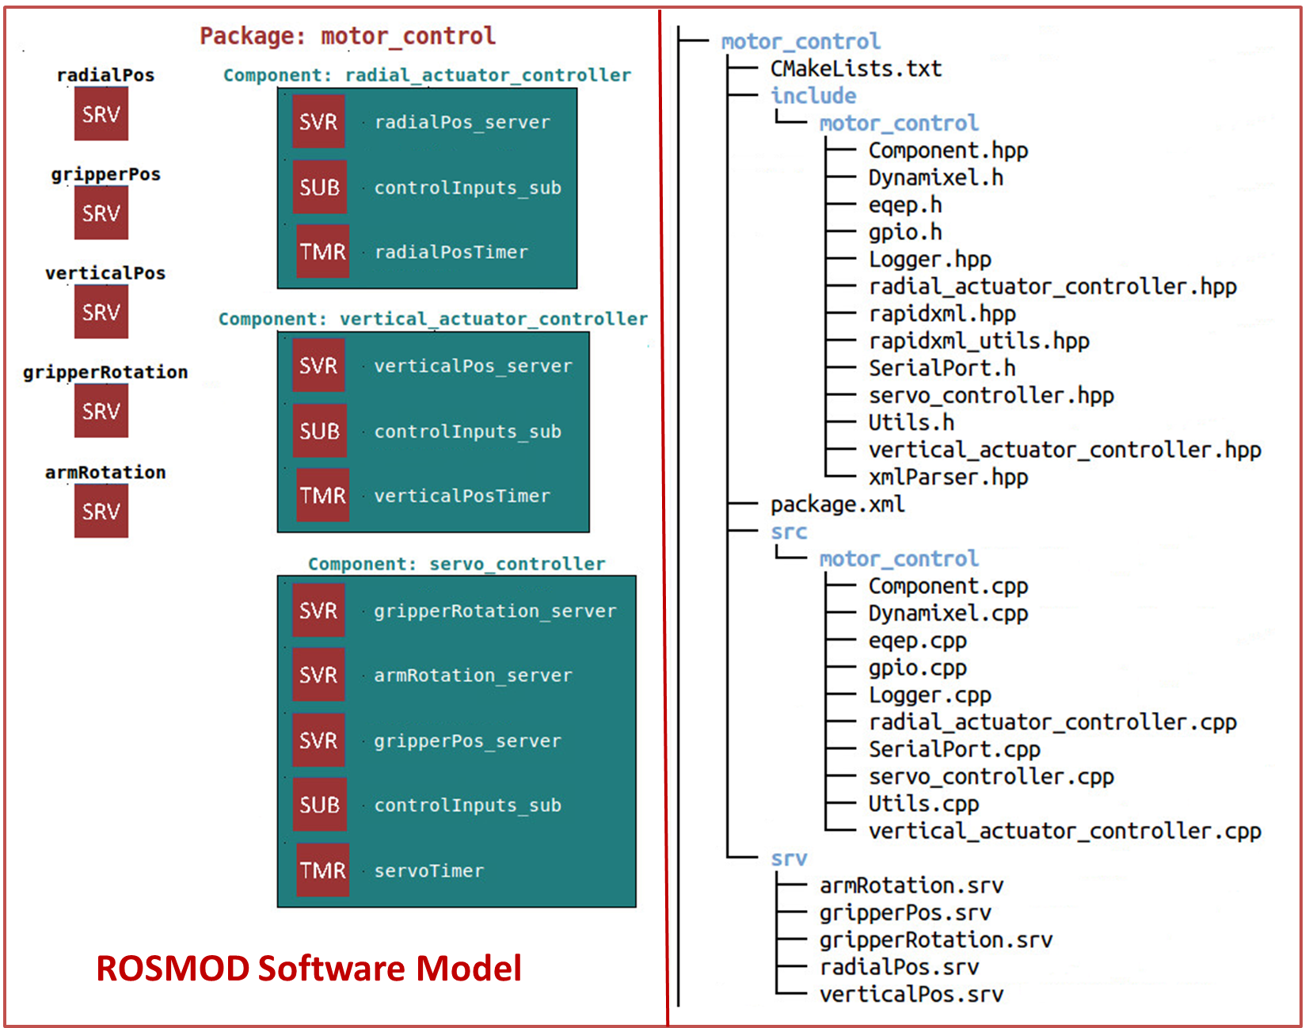
Workspace Generation
C++ Classes for each ROSMOD Component
Package-specific msg and srv files
Logging and XML parsing framework
Build system files
Code preservation markers and Doxygen comments
Follows ROS Package guidelines

Slide 9
ROSMOD Application Development
Prepare a ROSMOD Model of the application: interfaces, architecture, deployment
Generate the ROS Workspace using ROSMOD
Generated code includes Code-Preservation Markers
Add business logic code to generated skeleton callbacks/operations
Add new components, ports, messages etc. to the model
Re-generate ROS Workspace
Previously added business logic code is preserved
Newly added modeling elements manifest as new code segments
No need to complete the ROSMOD model to begin implementing the application code
On-the-fly feature additions and rapid prototyping

Slide 10
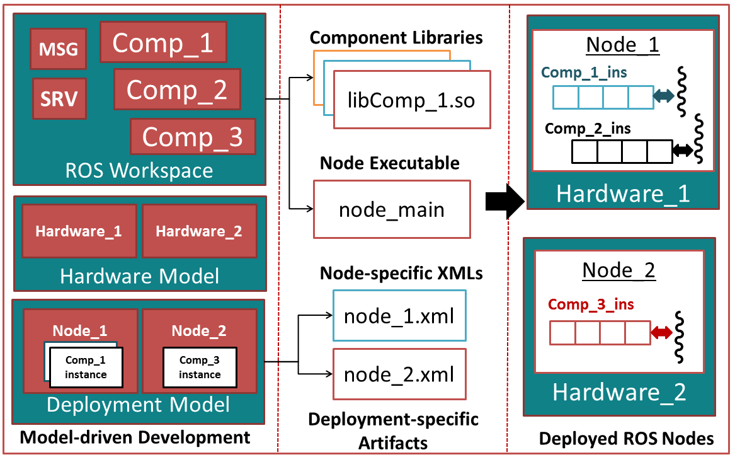
Software Deployment Infrastructure

Slide 11
Autonomous Ground Support Equipment (AGSE) Robot
NASA Student Launch Competition, 2014-2015
Vanderbilt Aerospace Club
Pranav Srinivas Kumar, William Emfinger, Dexter Watkins, Benjamin Gasser, Connor Caldwell, Frederick Folz, Alex Goodman, Christopher Lyne, Jacob Moore, Cameron Ridgewell, Robin Midgett and Amrutur Anilkumar

Slide 12
NASA Student Launch Competition
Research-based Competition: Stimulate Rapid, Low-cost Development of Rocket Propulsion & Space Exploration Systems
8 Month Cycle: Design, Fabrication, and Testing of Flight Vehicles, Payloads and Ground Support Equipment
2014-2015 Competition: Simulate a Mars Ascent Vehicle (MAV)
Perform Sample Recovery from the Martian Surface
Design & Deploy an AGSE Robot
Autonomously retrieve a sample off the ground
Store sample in the payload bay of the rocket
Launch MAV rocket to an altitude of 3000 ft. and recover sample

Slide 13
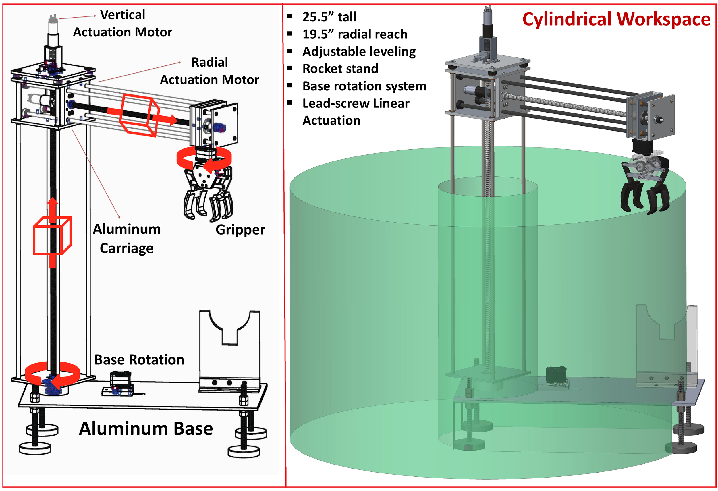
AGSE Overview

Slide 14
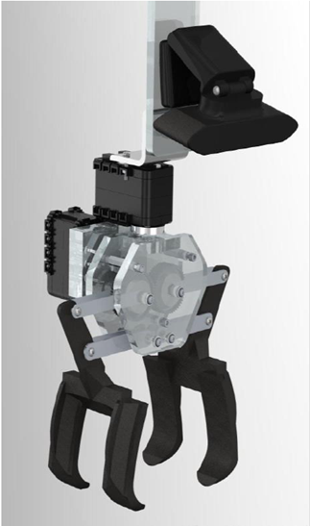
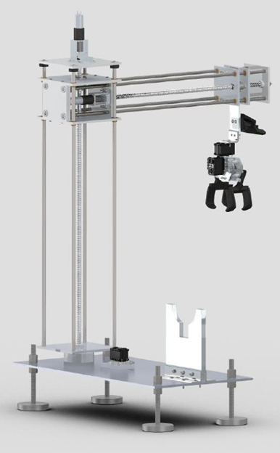
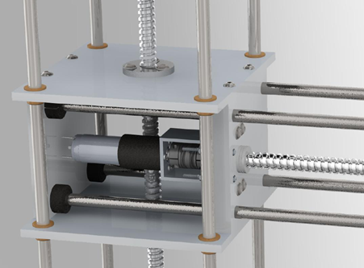
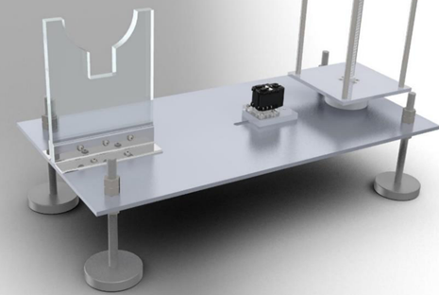
Mechanical Construction

Slide 15
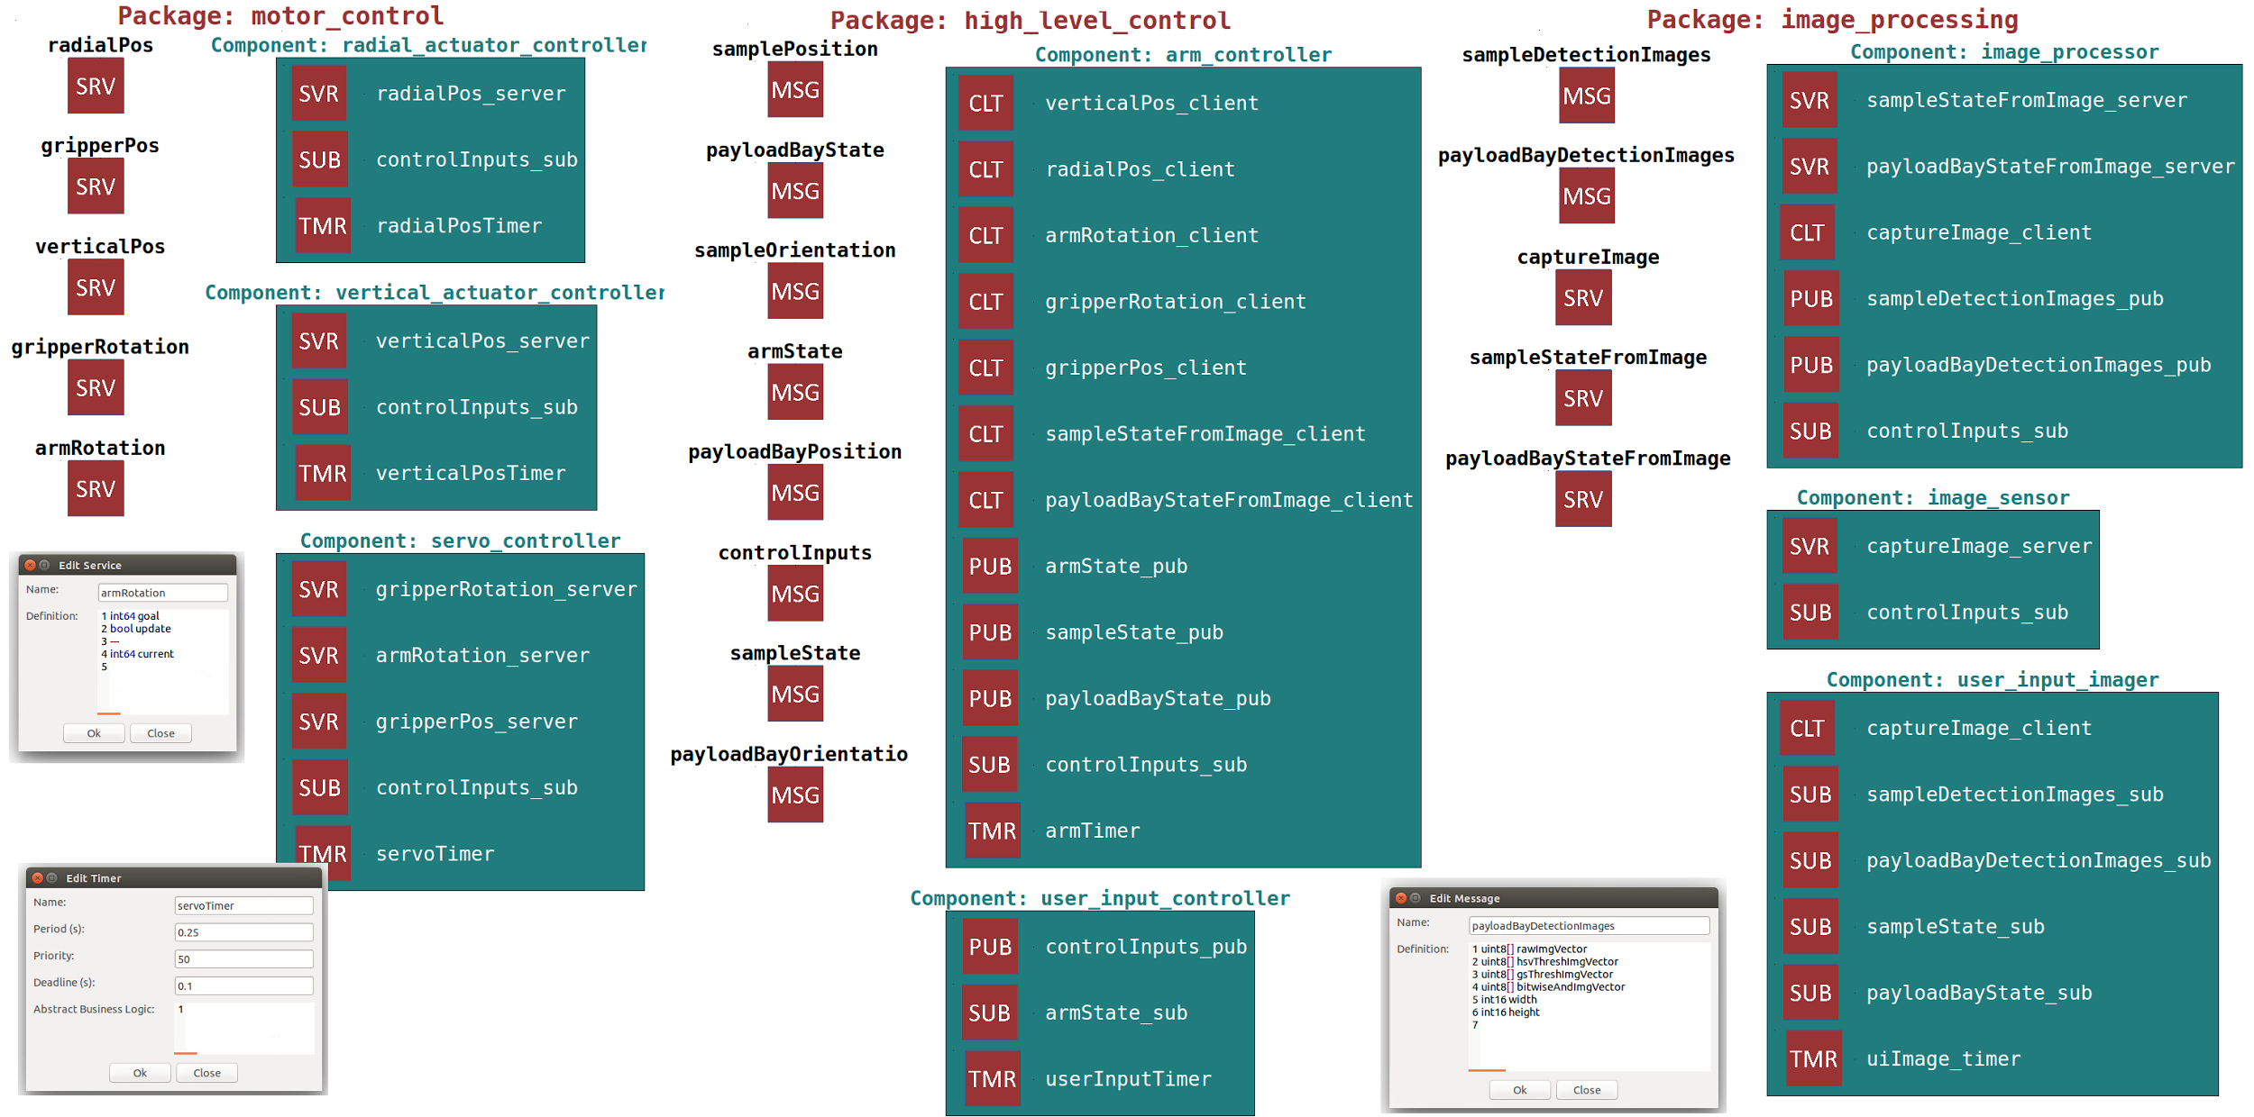
ROSMOD AGSE Software Model

Slide 16
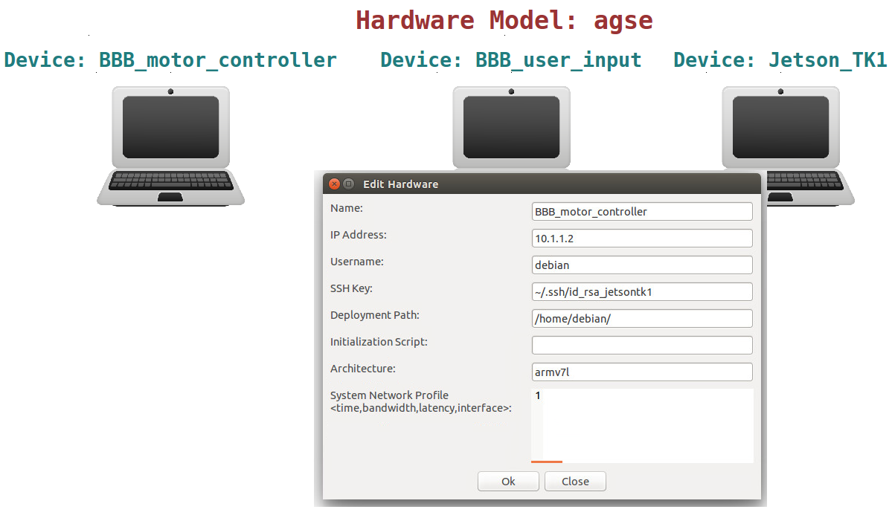
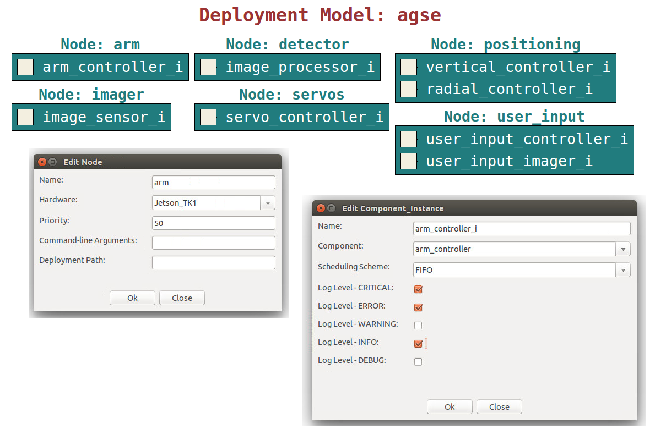
AGSE Software Deployment

Slide 17
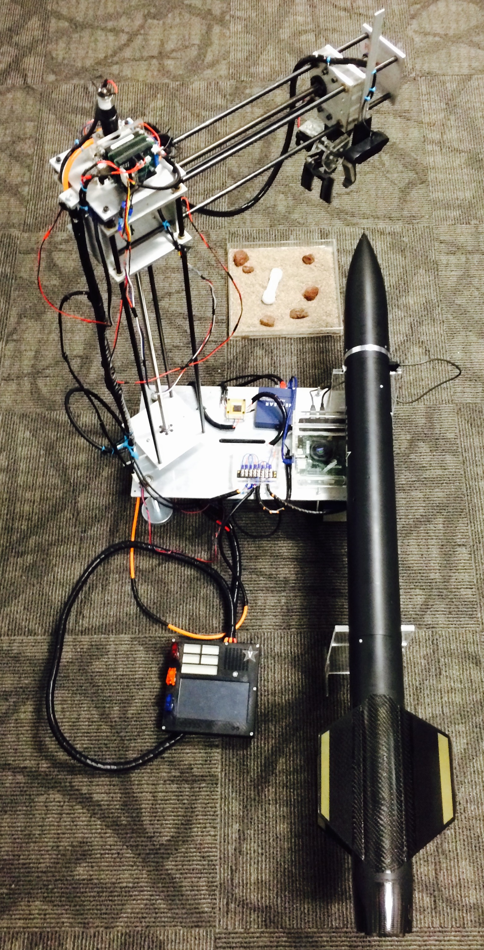
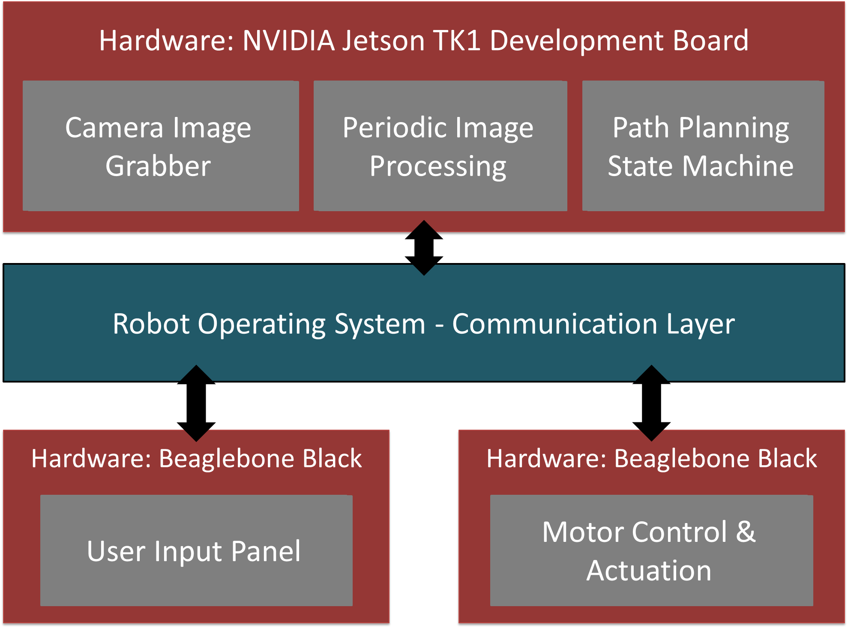
ROSMOD AGSE Deployment

Slide 18
Software Rapid Prototyping
Iterative Design-Generate-Deploy-Test Cycle
ROSMOD generated nearly 60% of the AGSE software (6000+ lines)
Takes a few seconds
Preserves already written code
Developers fill in the missing pieces
Quick and easy integration with external libraries e.g. OpenCV
Overall software frequently redesigned and tweaked
Large portion of code development in under 3 weeks
Difficult without ROSMOD, especially with our small team

Slide 19
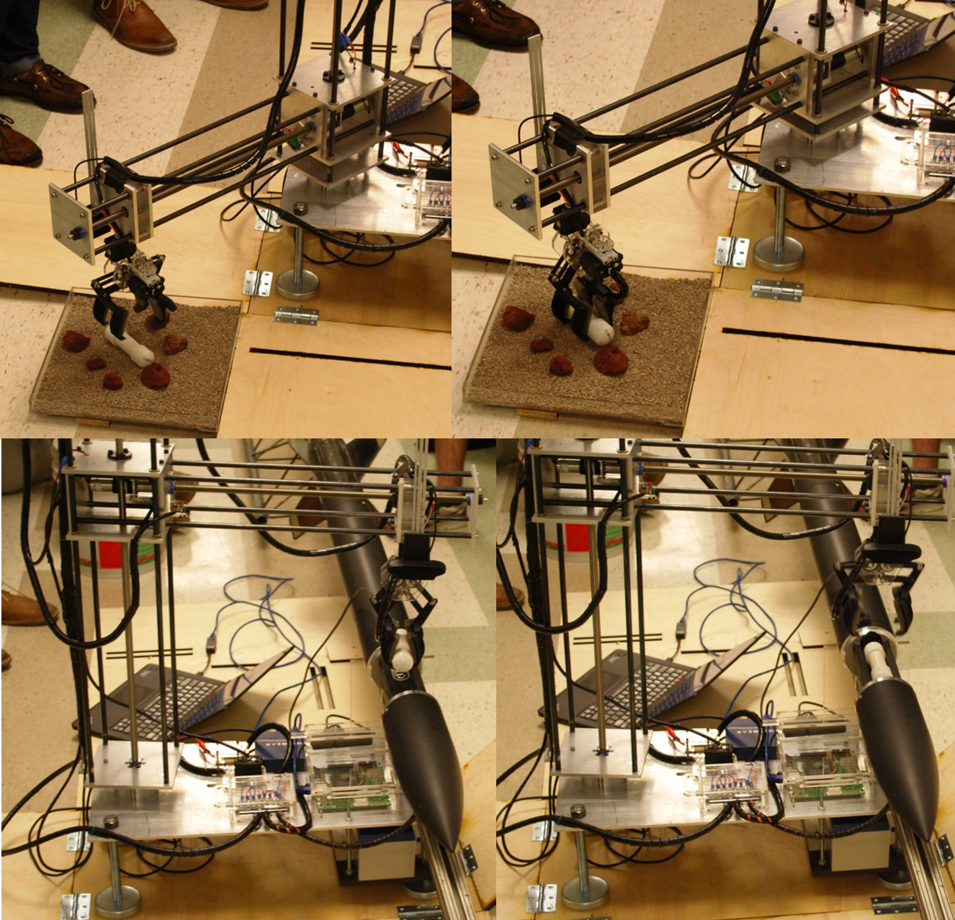
Competition Highlights
Long Night before Competition
Dynamixel AX12A Servo Failure
Replace with spare MX28T
Difficult communication protocol & mounting footprint
Mount new servo!
Fix servo_controller package!
Sample Recovery in under 4.5 mins.
We won ☺
Earned overall Autonomous Ground Support Equipment Award

Slide 20
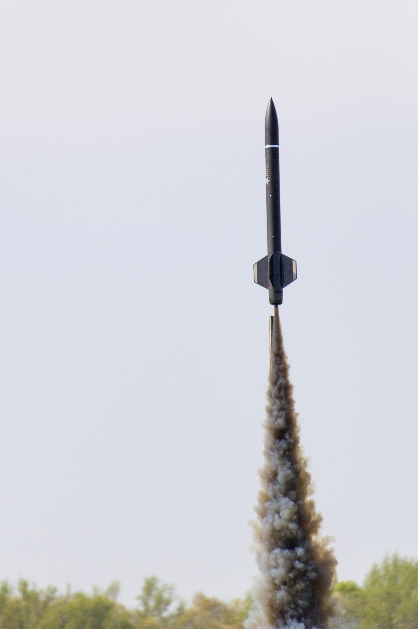
Links
ROSMOD GitHub Organization
https://github.com/rosmod
AGSE Software GitHub Repository
https://github.com/finger563/agse2015
Vanderbilt Aerospace Club
http://www.vanderbilt.edu/USLI/2015/

